Slide 1

Hdfs (Hadoop distributed file system) & Name Node Issue
Harjinder Singh Gill

Slide 2
Outline
HDFS Goals & Assumptions
Master/Slave Architecture
Communication
Data Replication
Robustness / Fault Tolerance
Research On Name Node Stability
References

Slide 3
HDFS Goals & Assumptions

Slide 4
HDFS Basics
An open-source implementation of Google File System
Assume that node failure rate is high
Large files, some several GB large
Write-once-ready-many pattern
Reads are performed in a large streaming fashion
Large throughput instead of low latency
Moving computation is easier than moving data

Slide 5
HDFS Files
User data divided into 64MB blocks and replicated across local disks of cluster node to address:
Cluster network bottleneck
Cluster node crashes
Master/Slave Architecture
Master (Namenode) maintains a name space and metadata
Slaves (Datanodes): maintain three copies of each data block

Slide 6
Master / Slave Architecture

Slide 7
Namenode
Abitrator and repository for all HDFS metadata
Data never flows through Namenode
Executes file system namespace operations
open, close, rename files and directories
Determines mapping of blocks to Datanodes

Slide 8
EditLog & FsImage
Managed by Namenode
Stored in files on the local OS file system
EditLog
Transaction log
Records all changes to file system metadata
FsImage
Image of entire file system namespace
Mappings of blocks to files
File system properties
Stored in a file on the local OS file system

Slide 9
Datanodes
Serve read / write requests from client
Block creation, deletion and replication upon instruction from Namenode
No knowledge of HDFS files
Stores HDFS data in files on local file system
Determines optimal file count per directory
Creates subdirectories automatically

Slide 10
Communication

Slide 11
Communication Protocols
Layered on top of TCP/IP
RPC abstraction wraps protocols
ClientProtocol
Client talks to Namenode
Datanode Protocol
Datanodes talk to Namenode
Namenode never initiates any RPCs
It only responds to RPC requests

Slide 12
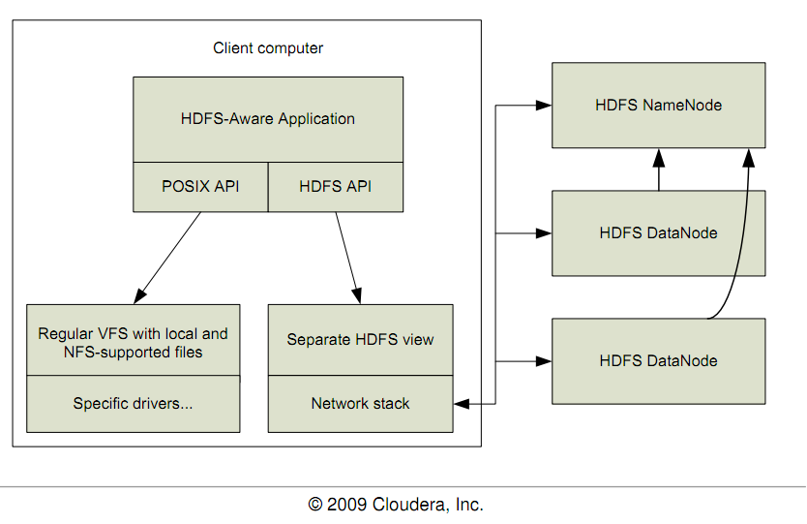
HDFS Client Block Diagram

Slide 13
HDFS: Hadoop Distributed File Systems
Client requests meta data about a file from namenode
Data is served directly from datanode
Application
HDFS namenode
(file name, block id)
HDFS Client
(block id, block location)
File namespace
/user/css534/input
block 3df2
instructions
state
(block id, byte range)
HDFS datanode
HDFS datanode
block data
Linux local file system
Linux local file system
…
…
CSS534
Lecture 6: Task Parallelism and MapReduce

Slide 14
File Read/Write in HDFS
File Read
File Write
1. open
Distributed
FileSystem
2. get block locations
1. create
Distributed
FileSystem
2. create
name node
name node
HDFS
client
NameNode
HDFS
client
NameNode
3. read
3. write
8. complete
FSData
InputStream
FSData
OutputStream
6. close
7. close
client JVM
client JVM
4. get a list of 3 data nodes
client node
client node
4. read from the closest node
5. write packet
6. ack packet
5. read from the 2nd closest node
data node
data node
data node
data node
data node
data node
DataNode
DataNode
DataNode
DataNode
DataNode
DataNode
If a data node crashed, the crashed node is removed, current block receives a newer id so as to delete the partial data from the crashed node later, and Namenode allocates an another node.
CSS534
Lecture 6: Task Parallelism and MapReduce

Slide 15
Data Replication

Slide 16
Replica Placement
Distinguishes HDFS from most other DFS
When replication factor == 3
Put one replica on local rack
Put one replica on different node on local rack
Put one replica on different node on different rack
Replicas do not evenly distribute across racks

Slide 17
Start-Up Process
Namenode enters Safemode
Replication does not occur in Safemode
Each Datanode sends Heartbeat
Each Datanode sends Blockreport
Lists all HDFS data blocks
Namenode creates Blockmap from Blockreports
Namenode exits Safemode
Replicate any under-replicated blocks

Slide 18
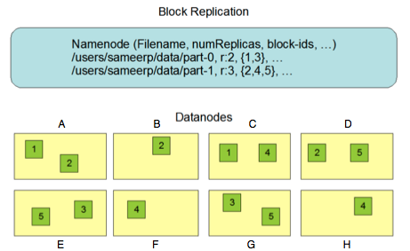
Datanode Blockreports

Slide 19
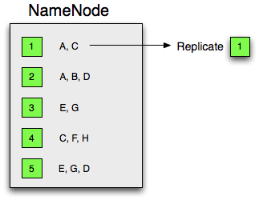
BlockMap and Replication

Slide 20
Checkpoint Process
Performed by Namenode
Two versions of FsImage
One stored on disk
One in memory
Applies all transactions in EditLog to in-memory FsImage
Flushes FsImage to disk
Truncates EditLog
Currently only occurs on start-up

Slide 21
Robustness / Fault Tolerance

Slide 22
Datanode Failure
Datanode sends periodic Heartbeats
Namenode
Datanode
Datanode
Datanode

Slide 23
Datanode Failure
Namenode marks Datanodes without recent heartbeat as dead
Does not forward any new I/O requests
Constantly tracks which blocks must be replicated with BlockMap
Initiates replication when necessary

Slide 24
Namenode Failure
Single Point of Failure for HDFS cluster
FsImage and EditLog are central data structures for HDFS
Corruption / loss of these files causes HDFS to become non-functional
Manual intervention is necessary
Automatic restart and failover of Namenode not yet supported (but planned)

Slide 25
Limitations

Slide 26
Limitations
Write-once model
Plan to support appending-writes
A namespace with an extremely large number of files exceeds Namenode’s capacity to maintain
Cannot be mounted by exisiting OS
Getting data in and out is tedious
Virtual File System can solve problem
Java API
Thrift API is available to use other languages

Slide 27
Research On Name Node Stability

Slide 28
Major Problem with hadoop Name Node
Unstable namenode(upto 2012. &version 2.0.0.)
Job Traker .
Short Supply of efficient/ Innovative programmers
Non Compatibility with other platforms
Not an easy platform to manage.

Slide 29
Name node…… (problem faced at initial phase)
Single Point of Failure for HDFS cluster
FsImage and EditLog are central data structures for HDFS
Corruption / loss of these files causes HDFS to become non-functional
Manual intervention is necessary
Automatic restart and failover of Namenode not yet supported [1].

Slide 30
Future work suggested in….[9]. (introduced in Hadoop 0.19.1 stable release)
Introduce an Secondary Name Node
Purpose:
To copy data from name node in case of failure.

Slide 31
Limitation.
Do not store Latest Editlog
Name Node is been Interrupted at regular intervals to Update checkpoints
It is not a name-node in the sense that data-nodes cannot connect to the secondary name-node
Cannot replace Name node
No automatic Failover.

Slide 32
Backup Node
he Backup node extends functionality of the Checkpointer by that it can receive online updates of the file system meta-data, apply them to its memory state and persist them on disks just like the name-node does. Thus at any time the Backup node contains an up-to-date image of the namespace both in memory and on local disk(s).
The Term Standby node is reserved for further extension of the backup node functionality, when cluster will be able to switch over to the new name-node if the active dies. This is mentioned in the "Warm standby provision" section of the design document.

Slide 33
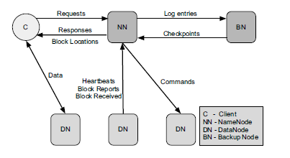
Cntd..
Backup Node is a subclass of the NameNode.[2]

Slide 34
Pros/Cons…..
Stores Latest Editlog
Name Node is been Interrupted only once to Update Starting checkpoint.
Can replace Name node
No automatic Failover.

Slide 35
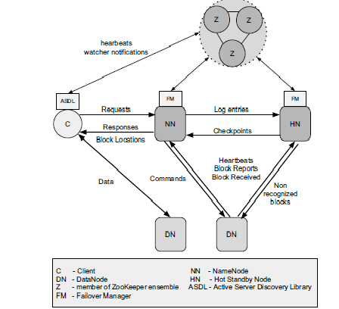
From Backup to Hot Standby: High Availability for HDFS[10]

Slide 36
Two approaches can be taken here:
(i) make the NameNodepropagate any change on replicas to the Hot Standby Node or
(ii) make the DataNodes also send their messages to the Hot Standby Node.

Slide 37
Cntd..
the data traffic between those nodes would be high. Soln: Messages can be consolidated and sent in batch to reduce the flow,
Still, it imposes more CPU and memory pressure on the NameNode, harming its performance.
The drawback is that there is no guarantee that NameNode and Hot Standby Node will share a common view for the blocks in the system.
However, some inconsistency is tolerable. If the Hot Standby Node misses some message, it may occasionally re-replicate a block, but data is never lost or corrupted.

Slide 38
Limitaions in Paper /Future Work
Still faces problem as it discards messages still in process messages from datanodes and take almost 20 min to switchover .
Can restart only once.
However, these limitations can be removed if ZooKeeper is used for leader election and the remaining Hot Standby Nodes are made to register with the new master.

Slide 39
References
http://hadoop.apache.org/hdfs/
http://en.wikipedia.org/wiki/Apache_Hadoop#Hadoop_Distributed_File_System
http://hadoop.apache.org/common/docs/r0.20.0/hdfs_design.pdf
Bo Dong; Jie Qiu; Qinghua Zheng; Xiao Zhong; Jingwei Li; Ying Li; , "A Novel Approach to Improving the Efficiency of Storing and Accessing Small Files on Hadoop: A Case Study by PowerPoint Files," Services Computing (SCC), 2010 IEEE International Conference on , vol., no., pp.65-72, 5-10 July 2010
Attebury, G.; Baranovski, A.; Bloom, K.; Bockelman, B.; Kcira, D.; Letts, J.; Levshina, T.; Lundestedt, C.; Martin, T.; Maier, W.; Haifeng Pi; Rana, A.; Sfiligoi, I.; Sim, A.; Thomas, M.; Wuerthwein, F.; , "Hadoop distributed file system for the Grid," Nuclear Science Symposium Conference Record (NSS/MIC), 2009 IEEE , vol., no., pp.1056-1061, Oct. 24 2009-Nov. 1 2009
Shvachko, K.; Hairong Kuang; Radia, S.; Chansler, R.; , "The Hadoop Distributed File System," Mass Storage Systems and Technologies (MSST), 2010 IEEE 26th Symposium on , vol., no., pp.1-10, 3-7 May 2010
Thusoo, A.; Sarma, J.S.; Jain, N.; Zheng Shao; Chakka, P.; Ning Zhang; Antony, S.; Hao Liu; Murthy, R.; , "Hive - a petabyte scale data warehouse using Hadoop," Data Engineering (ICDE), 2010 IEEE 26th International Conference on , vol., no., pp.996-1005, 1-6 March 2010
Jacob Leverich and Christos Kozyrakis. 2010. On the energy (in)efficiency of Hadoop clusters.SIGOPS Oper. Syst. Rev. 44, 1 (March 2010), 61-65.
Konstantin Shvachko, Hairong Kuang, Sanjay Radia, Robert Chansler .The Hadoop Distributed File System.Yahoo! Sunnyvale, California USA,,IEEE Transections-2010
Andr´e Oriani and Islene C. Garcia ‘The Hadoop Distributed File System”. 31st International Symposium on Reliable Distributed Systems,IEEE-2012 . DOI 10.1109/SRDS.2012.33

